Slide 1
Tutorial Machine Learning in Solid Mechanics
Task 2: Hyperelasticity
Xin Xiong ,Huasen Luo
December 17, 2024

Slide 2
Agenda
1
Data preparation
2
Neural network model
3
Physics-augmented neural network model
4
Concentric sampled deformation gradients
5
Homogenized cubic lattice metamaterials

Slide 3
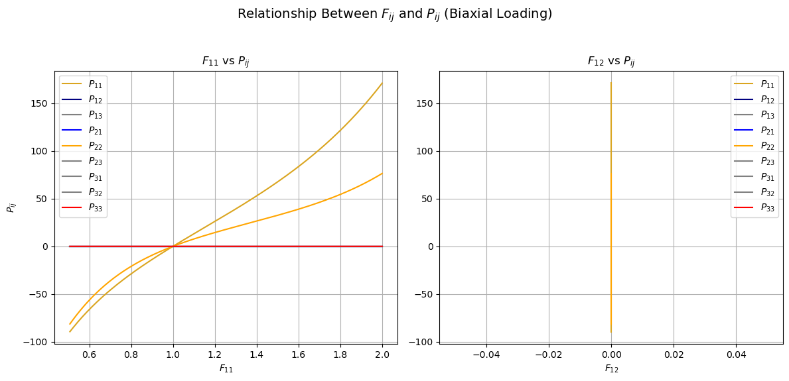
1.1 Data import

Slide 4
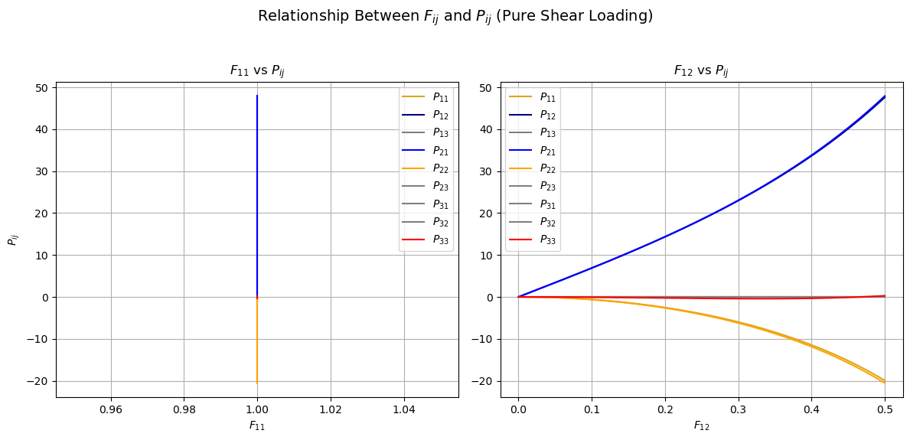
1.1 Data import

Slide 5
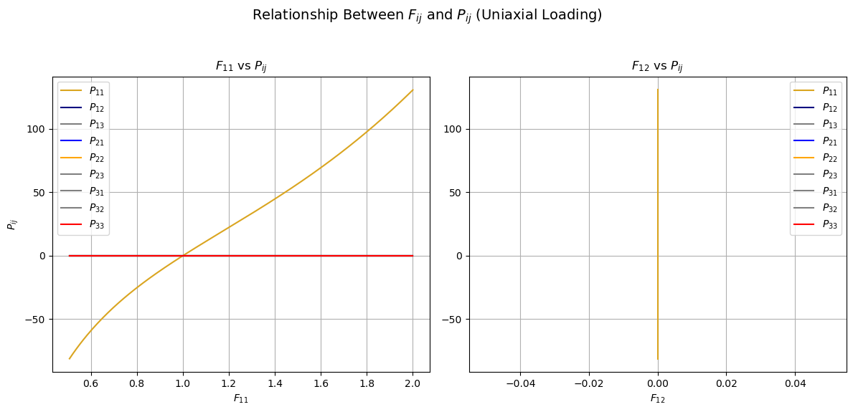
1.1 Data import

Slide 6
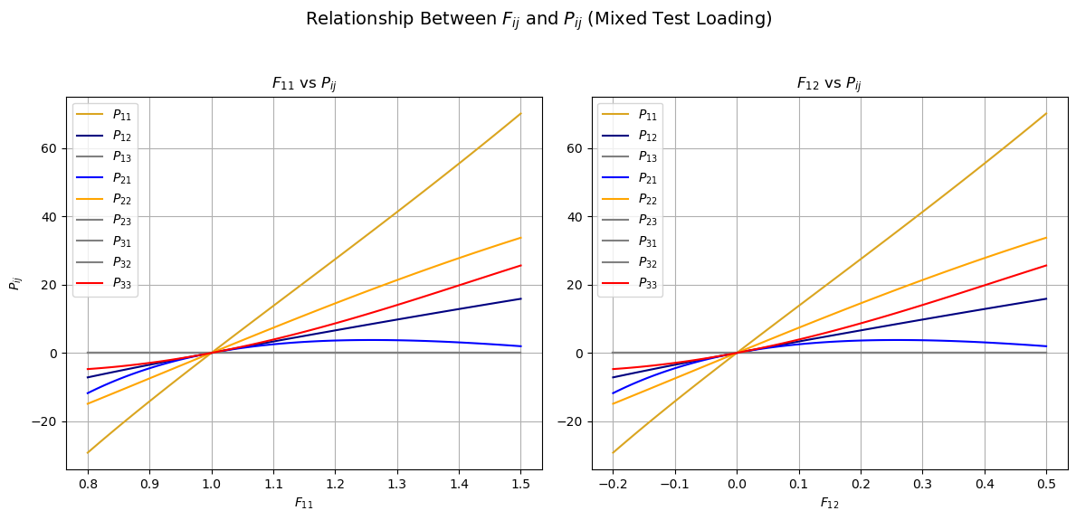
1.1 Data import

Slide 7
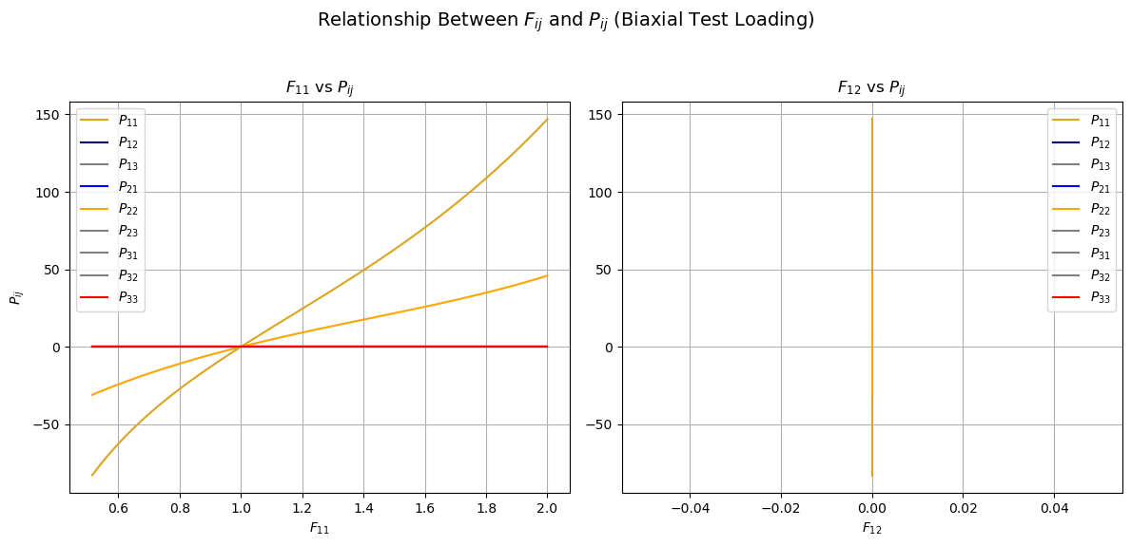
1.1 Data import

Slide 8
1.1 Data import
Conclusion
Biaxial load paths​
Mixed test load
Pure shear load paths​
Extrapolation dataset
Uniaxial load paths
Biax test load
Biaxial load paths​
Interpolation​ dataset
Notes:
To determine whether the test cases involve interpolation or extrapolation:
Compare the ranges of 𝐹, 𝑃, and 𝑊 in the calibration and test datasets using the output of the compare_ranges
Interpolation occurs if the test dataset values lie within the ranges of the calibration dataset.
Extrapolation occurs if the test dataset values lie outside the ranges of the calibration dataset.
Based on the code logic:
If the printed ranges from compare_ranges() show that 𝐹F, 𝑃P, or 𝑊W in the test dataset exceed the minimum or maximum values of the calibration dataset, then the test dataset involves extrapolation.
If all test values fall within the calibration ranges, it is interpolation.

Slide 9
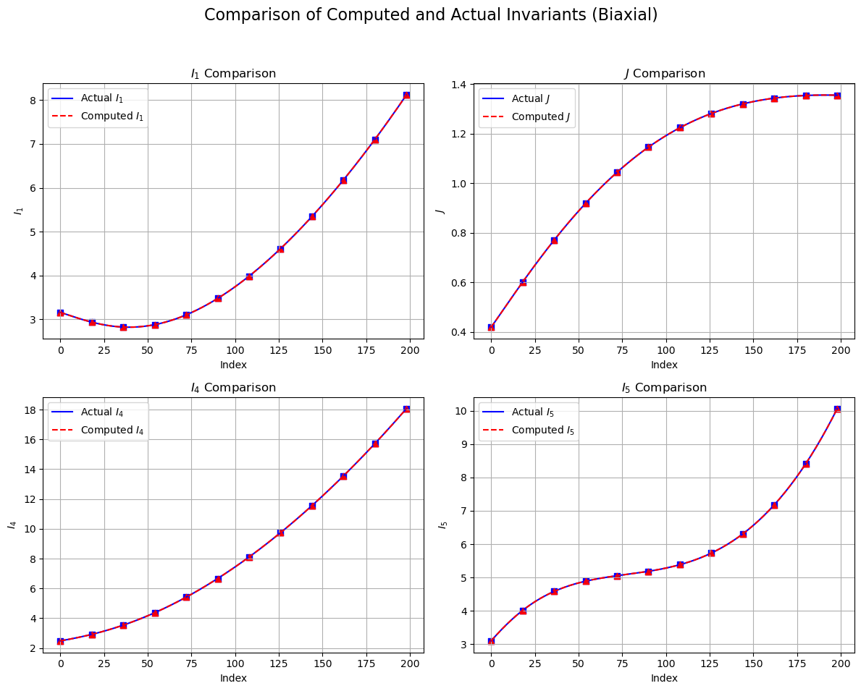
1.2 Analytical potential
Comparison of Computed and Actual Invariants(Biaxial):
It's the same.

Slide 10
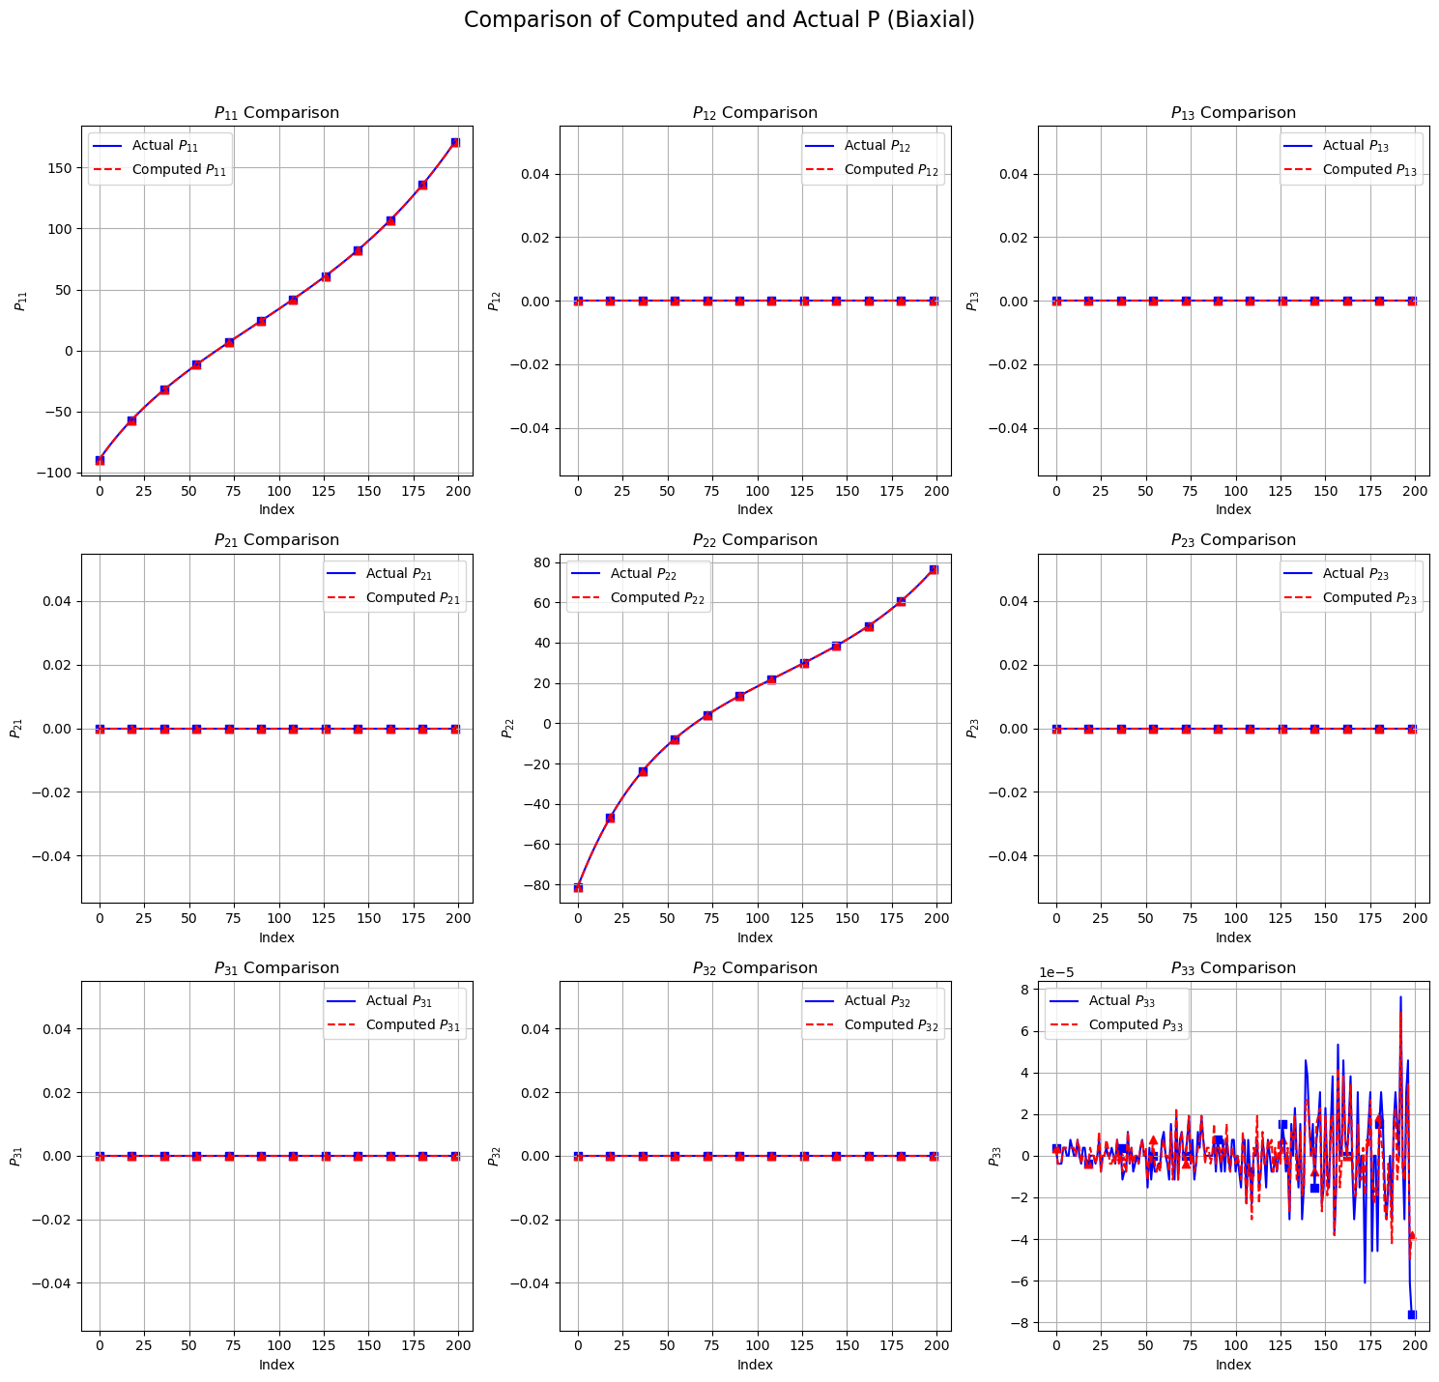
1.2 Analytical potential
Comparison of Computed and actual P (Biaxial):
It's the same.

Slide 11
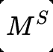
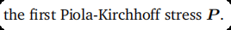
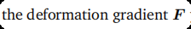
2.1 Model implementation
Introduction
input
output
Correspondence Between Physical/Mathematical Conditions and Model Structure：​
Satisfy the objectivity and material symmetry conditions.​
Notes:
The input C = F"F of the model is a rotation invariant, so it satisfies the objectivity condition,
Continuity and differentiability: The output of the neural network is a continuous and differentiable function of ℃, which is of great significance to numerical stability.
Flexibility: The model can adapt to complex nonlinear stress-strain relationships
Data consistency: Within the range of the calibration data set, the model can fit the mapping of C→>P well.
Numerical efficiency: Directly outputting P from C simplifies the calculation process and is suitable for large-scale real-time applications,

Slide 12
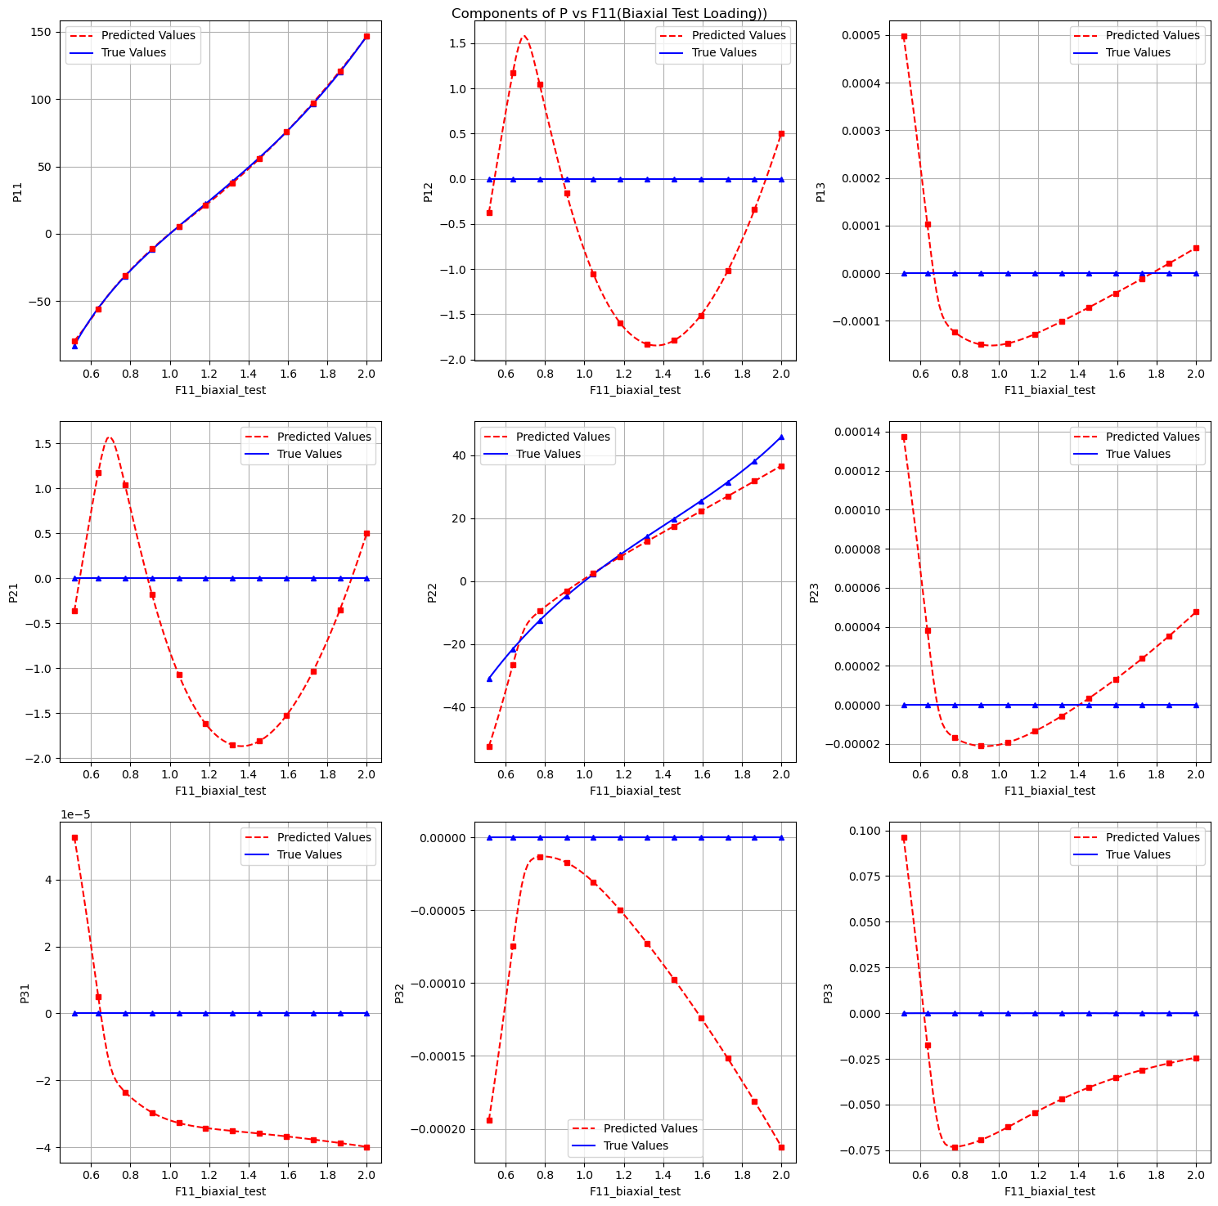
2.2 Model calibration
Components of P vs F11 (Biaxial Test Loading):

Slide 13
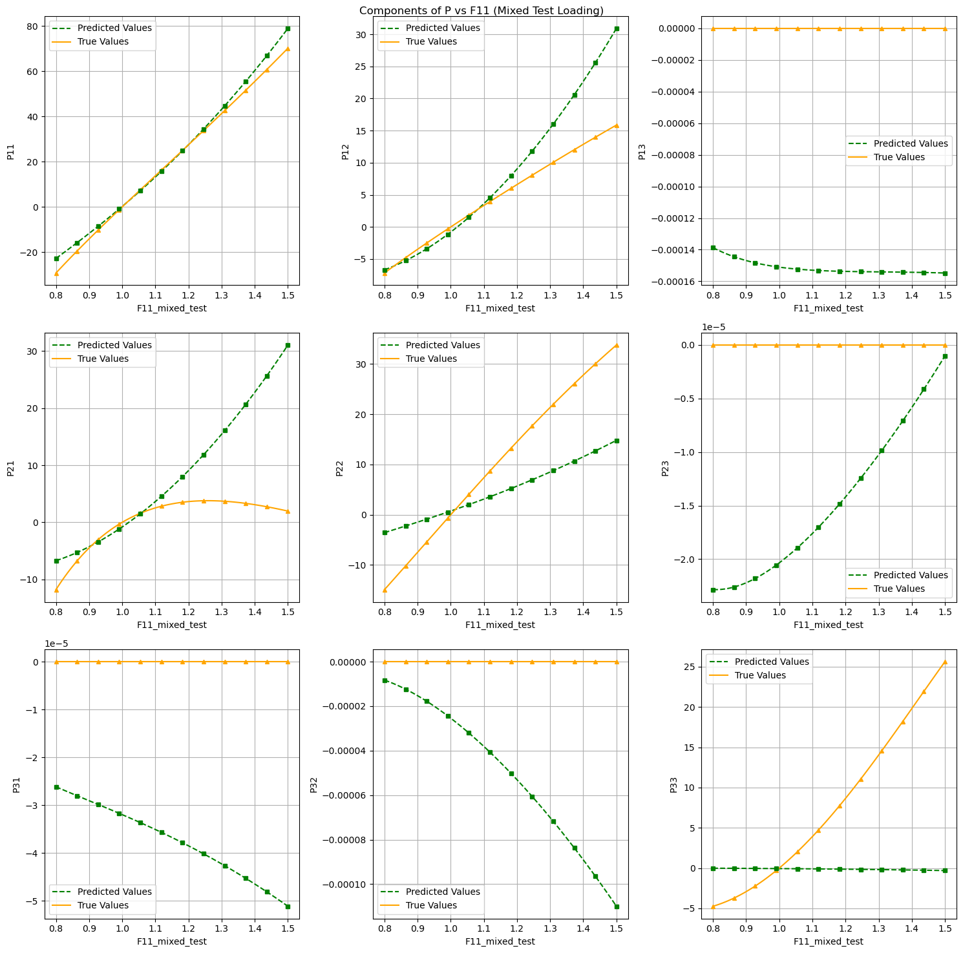
2.2 Model calibration
Components of P vs F11 (Mixed Test Loading):

Slide 14
2.2 Model calibration
1. Is the model able to interpolate the calibration dataset?
Yes, the model demonstrates interpolation ability on the calibration dataset; however, the performance is not particularly outstanding.
2. Is the model able to predict the unseen load cases of the test dataset?
No, the model is not able to accurately predict the unseen load cases in the test dataset. This could be due to overfitting to the calibration data or the presence of more complex, unseen load patterns in the test set.

Slide 15
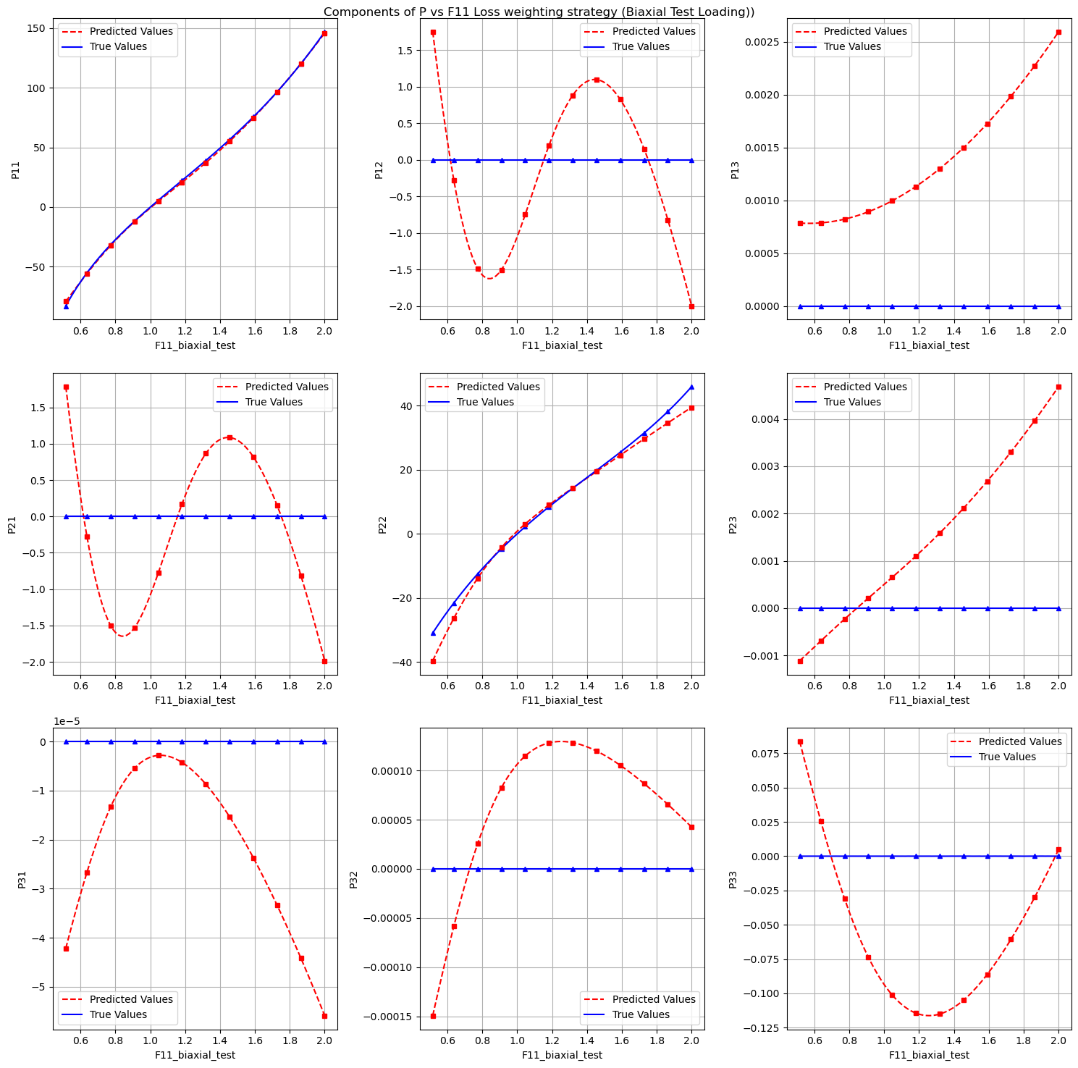
2.3 Loss weighting strategy
Components of P vs F11 Loss weighting strategy (Biaxial Test Loading):

Slide 16
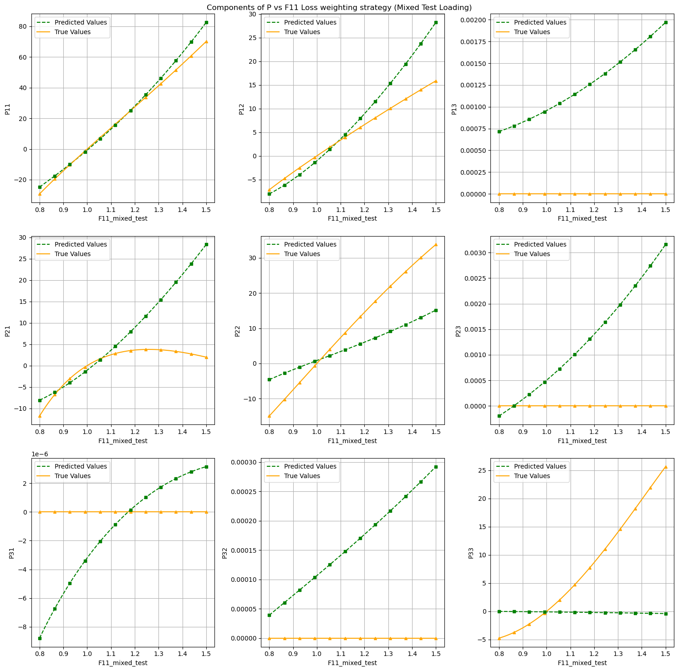
2.3 Loss weighting strategy
Components of P vs F11 Loss weighting strategy ((Mixed Test Loading):

Slide 17
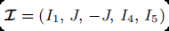

3.1 Model implementation
Introduction
input
output
optimizers
The weights for J in the first hidden layer are allowed to be positive or negative.
−J is introduced to ensure the polyconvexity constraint.
Correspondence Between Physical/Mathematical Conditions and Model Structure：
Satisfy the objectivity and material symmetry conditions.
Calculates P (stress) via gradients, ensuring the physical correctness of the model.

Slide 18
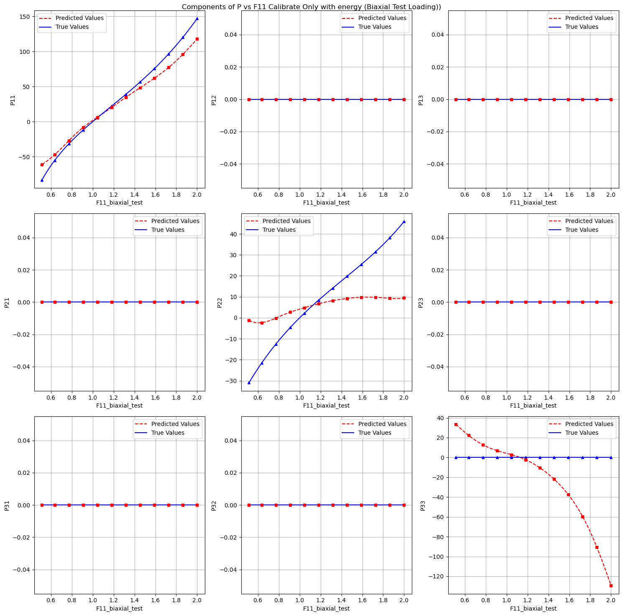
3.2 Model calibration
Components of P vs F11 Calibrate Only with Energy (Biaxial Test Loading):

Slide 19
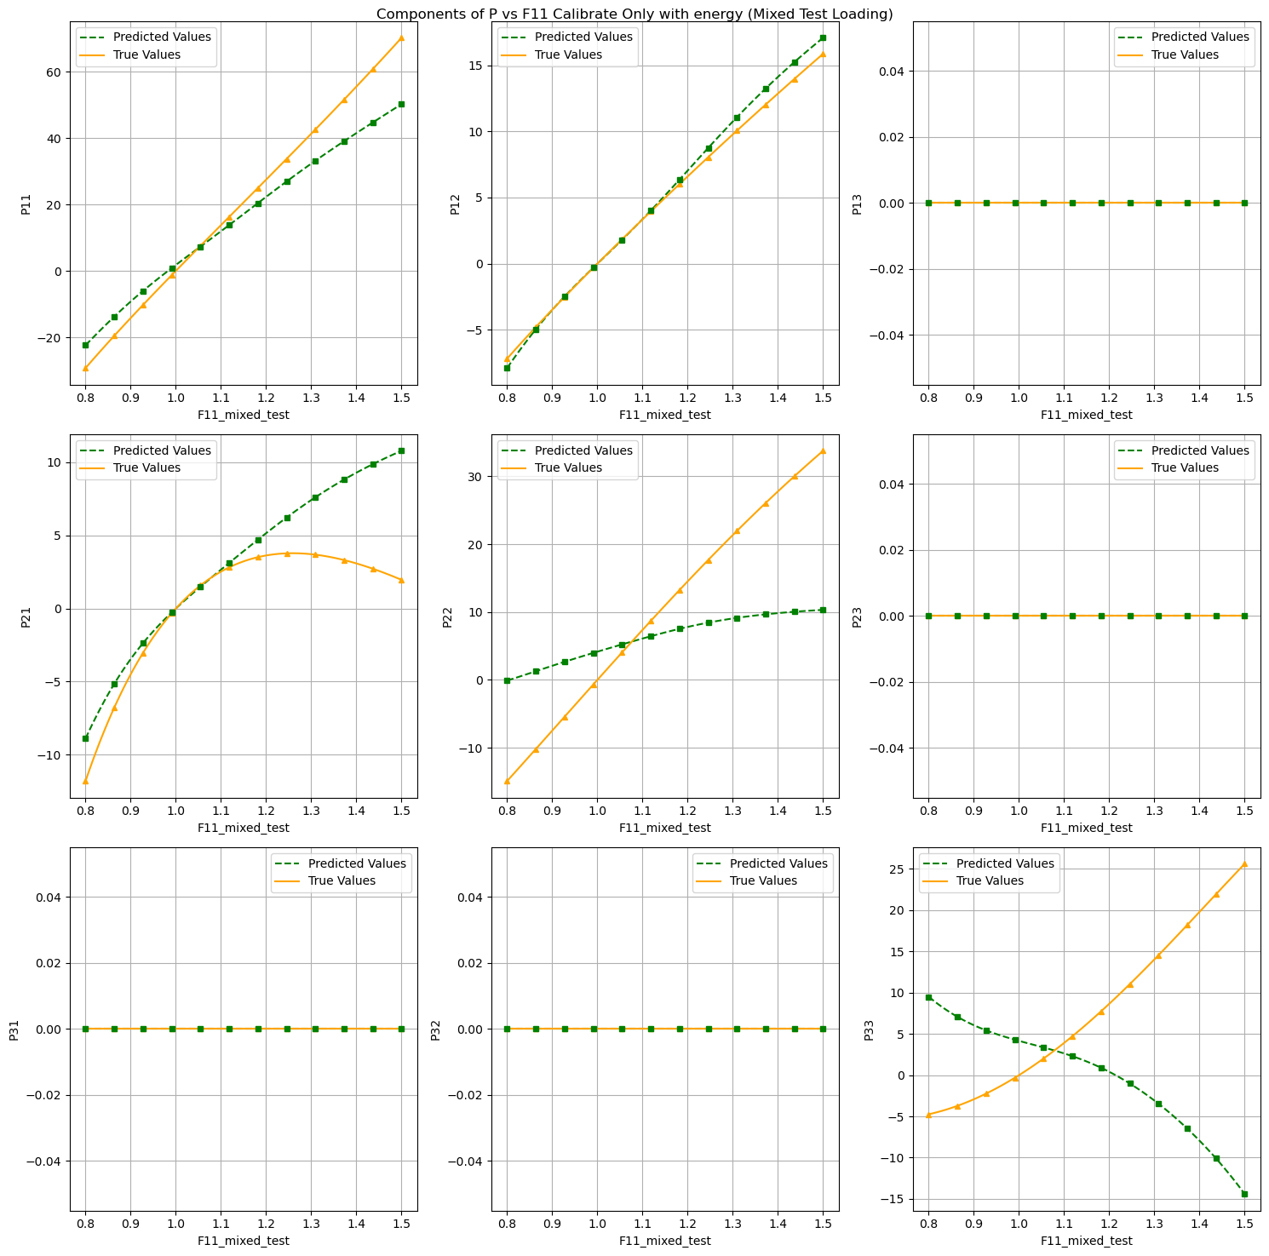
3.2 Model calibration
Components of P vs F11 Calibrate Only with Energy (Mixed Test Loading):

Slide 20
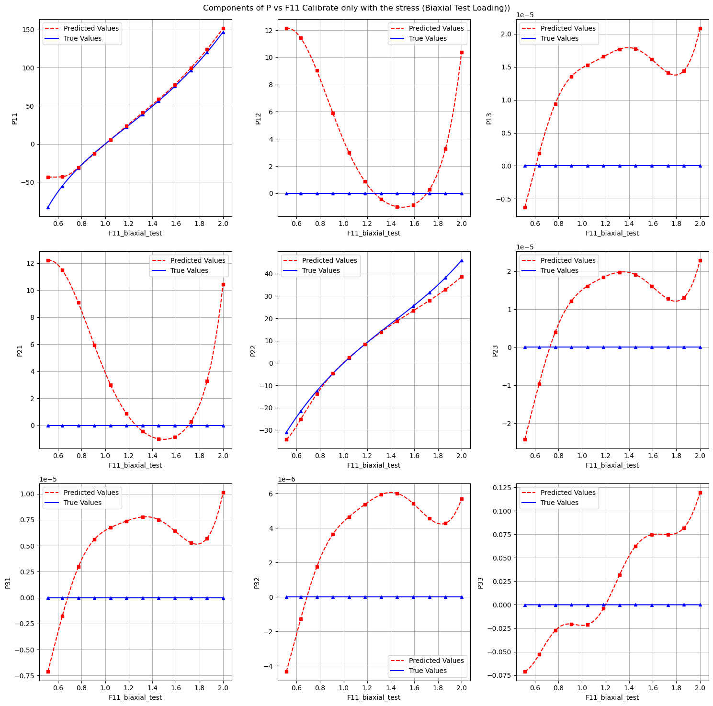
3.2 Model calibration
Components of P vs F11 Calibrate Only with Stress (Biaxial Test Loading):

Slide 21
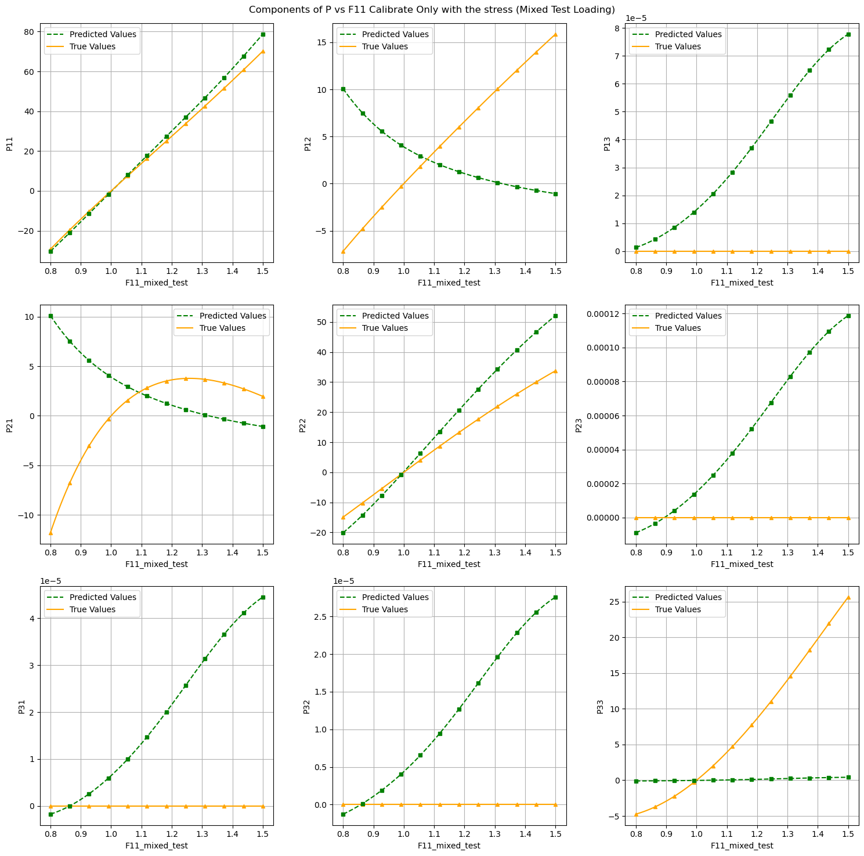
3.2 Model calibration
Components of P vs F11 Calibrate Only with Stress (Mixed Test Loading):

Slide 22
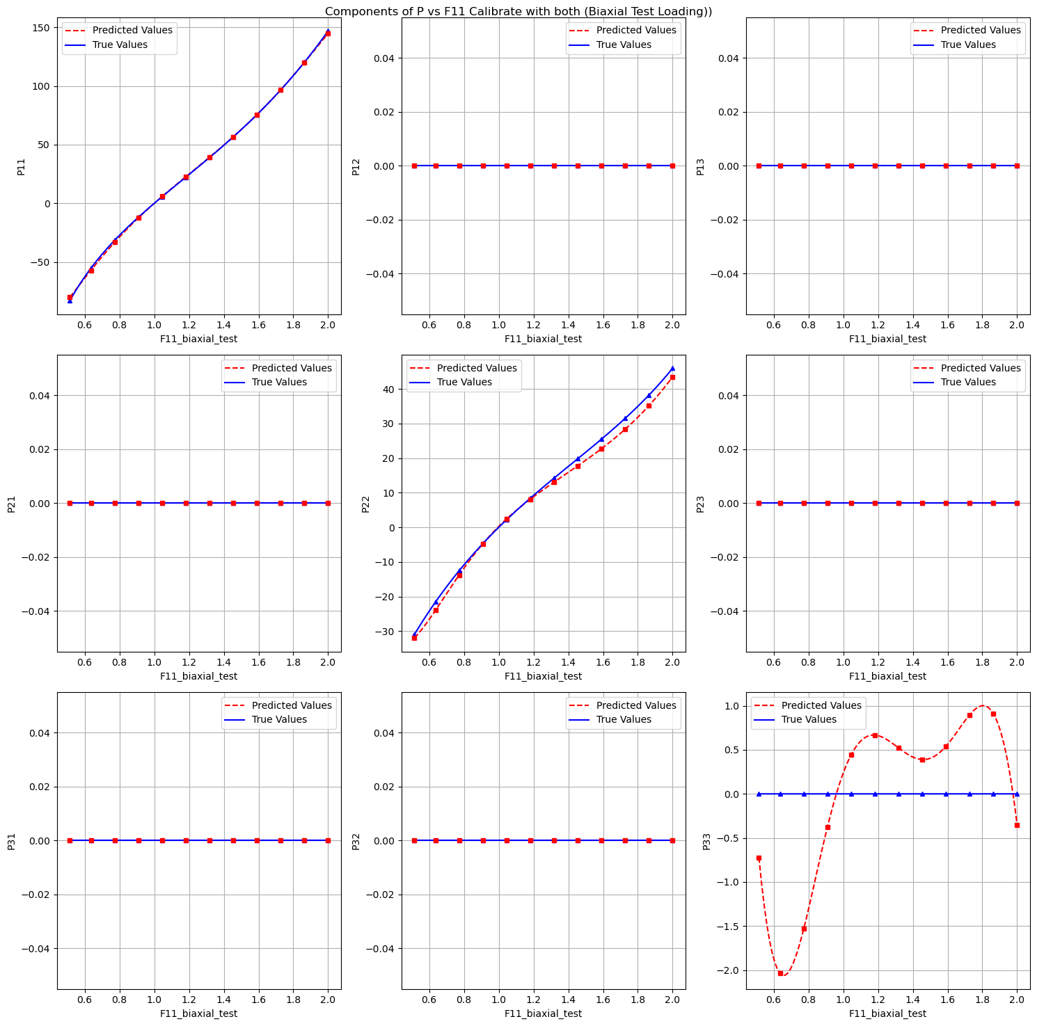
3.2 Model calibration
Components of P vs F11 Calibrate with Both (Biaxial Test Loading):

Slide 23
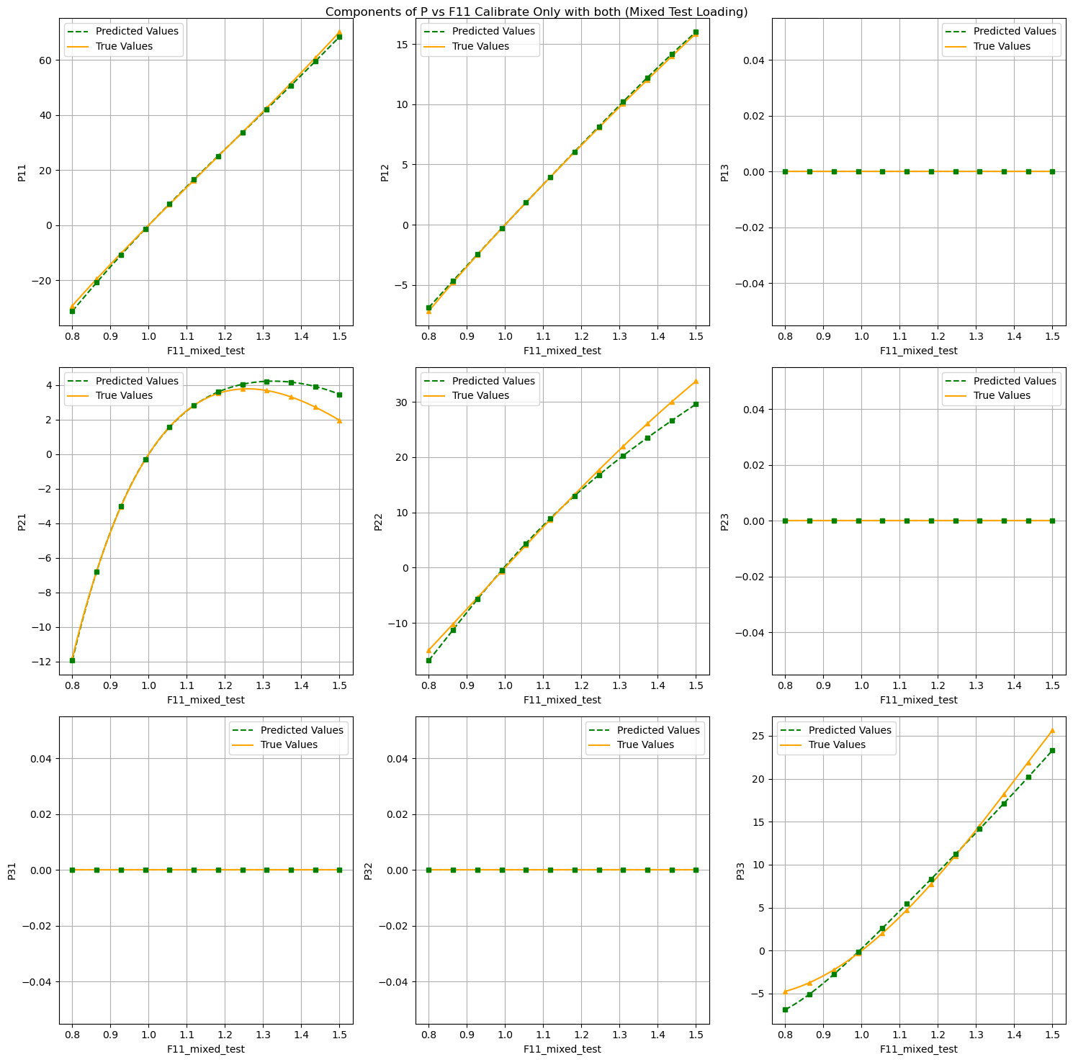
3.2 Model calibration
Components of P vs F11 Calibrate with Both (Mixed Test Loading):

Slide 24
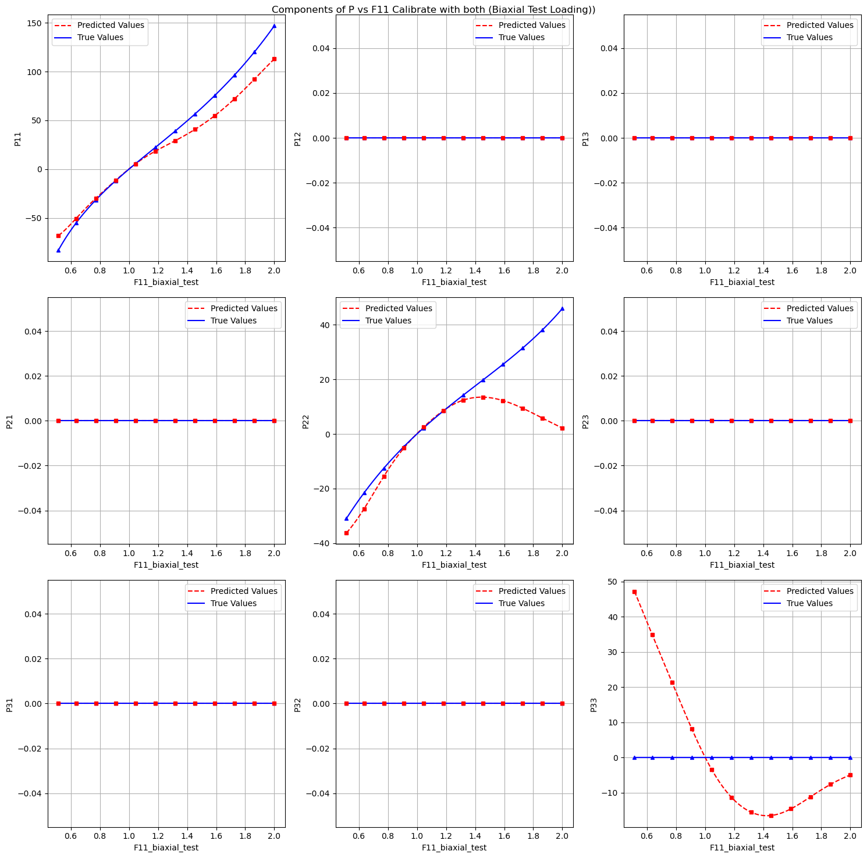
3.2 Model calibration
Components of P vs F11 Calibrate with only on uniaxial tension (Biaxial Test Loading):

Slide 25
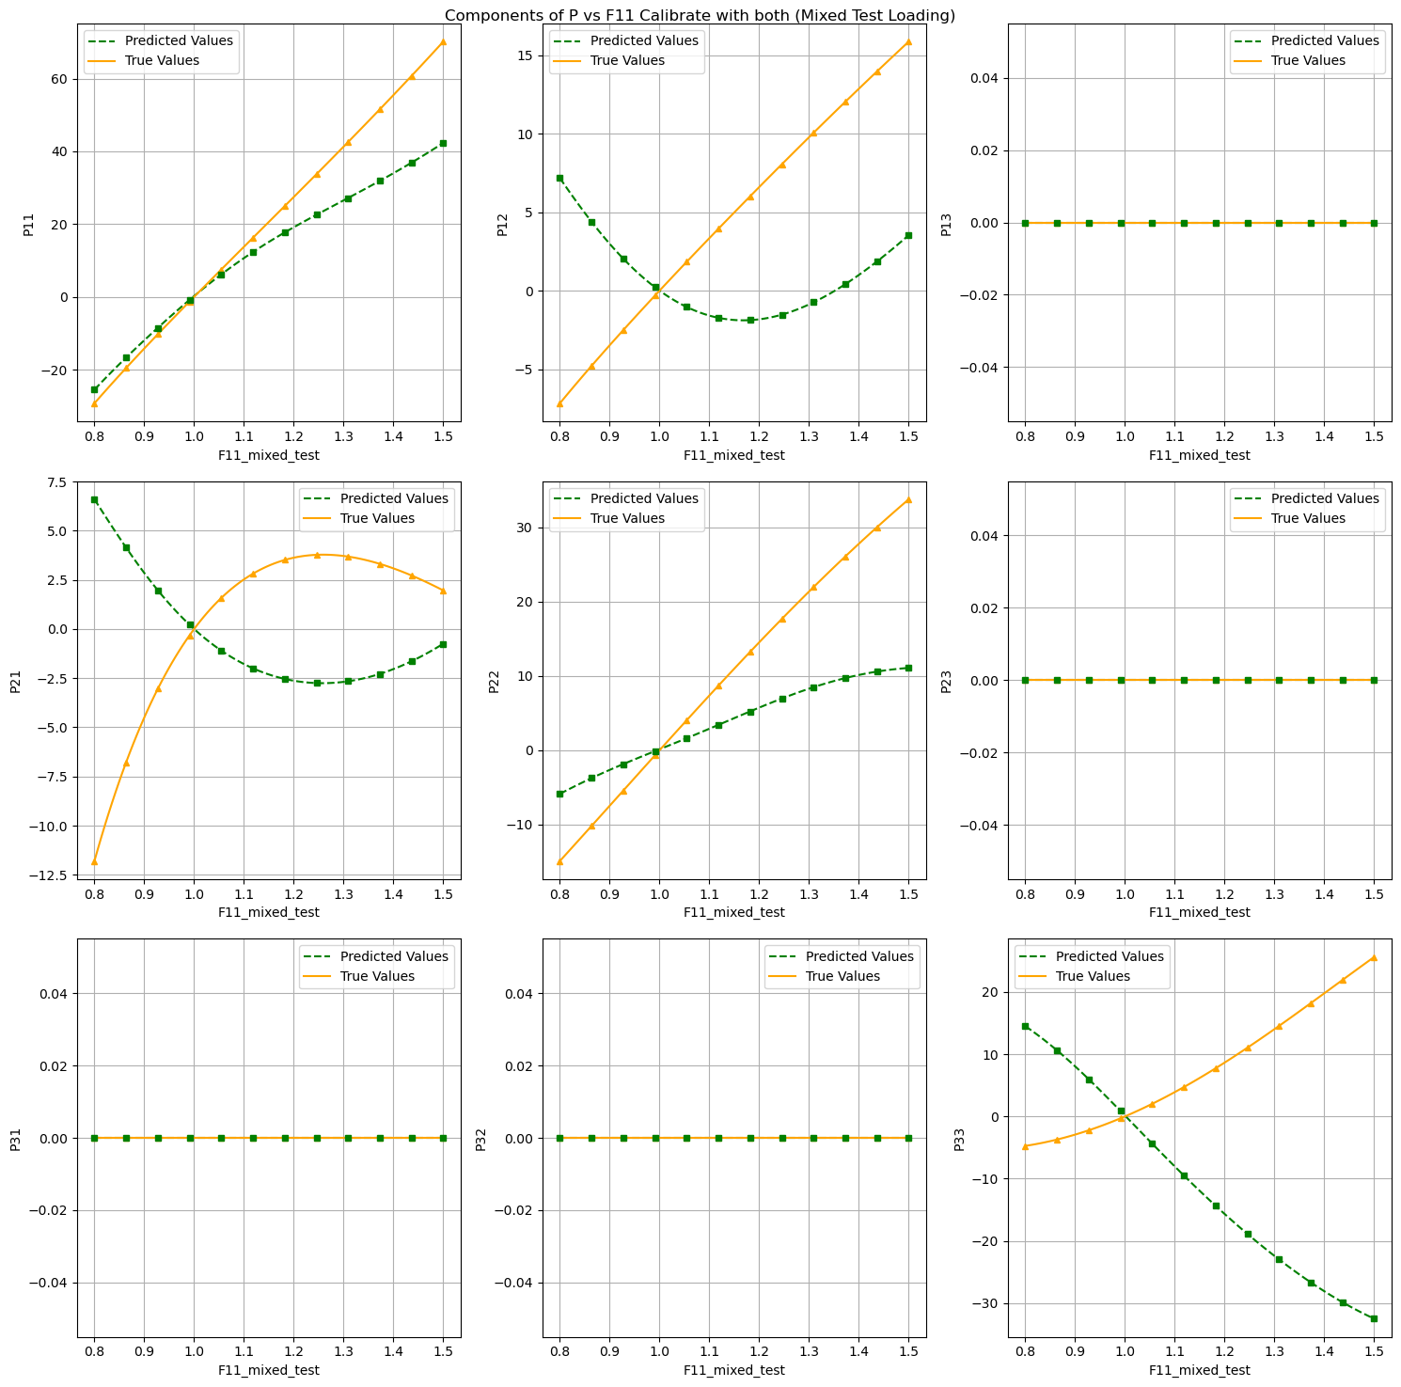
3.2 Model calibration
Components of P vs F11 Calibrate with both only on uniaxial tension (Mixed Test Loading):

Slide 26
3.2 Model calibration
1. Is the model able to interpolate the calibration dataset?
Yes
2. Is the model able to predict the unseen load cases of the test dataset?
Yes
3. Use different load paths for the calibration of the model, Is the model still able to extrapolate to the other cases?
No

Slide 27
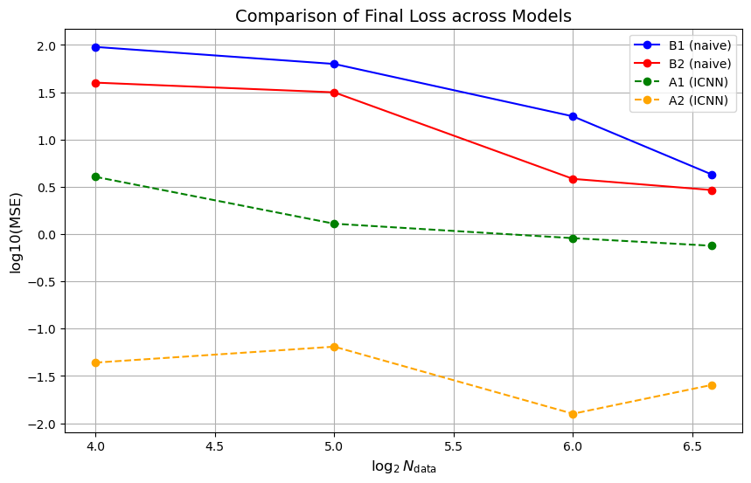
4. Concentric sampled deformation gradients
B1: naive model
2 hidden layer
(16,16)
B2: naive model
4 hidden layer
(64,64,64,64)
A1: ICNN model
1 hidden layer
(8)
A2: ICNN model
2 hidden layer
(16,16)
Notes:
1. Differences in the generalization of the models:
Physics-Augmented Model: Shows excellent generalization performance even with a smaller number of calibration paths. It achieves lower errors (MAE and MSE) across test datasets.
Naive Model: Generalization performance is poor, especially with fewer calibration paths. This is because the naive model lacks inductive biases and relies solely on data.
2. Difference in the required network size/calibration dataset size:
Physics-Augmented Model: Requires smaller network sizes due to its inherent physics-informed architecture; Needs fewer calibration paths to generalize effectively.
Naive Model: Requires larger network sizes to capture the complexity of the data; Needs a significantly larger calibration dataset to achieve similar performance as the physics-augmented model.
3. The smallest possible architecture for each model:
Physics-Augmented Model: Smallest architecture: 2 hidden layers, each with 32 neurons.
Naive Model: 2 hidden layers, each with 128 neurons.
4. The inductive bias of both NN models:
Physics-Augmented Model: Physics-informed.
Naive Model: Data-driven, no physical constraints.

Slide 28
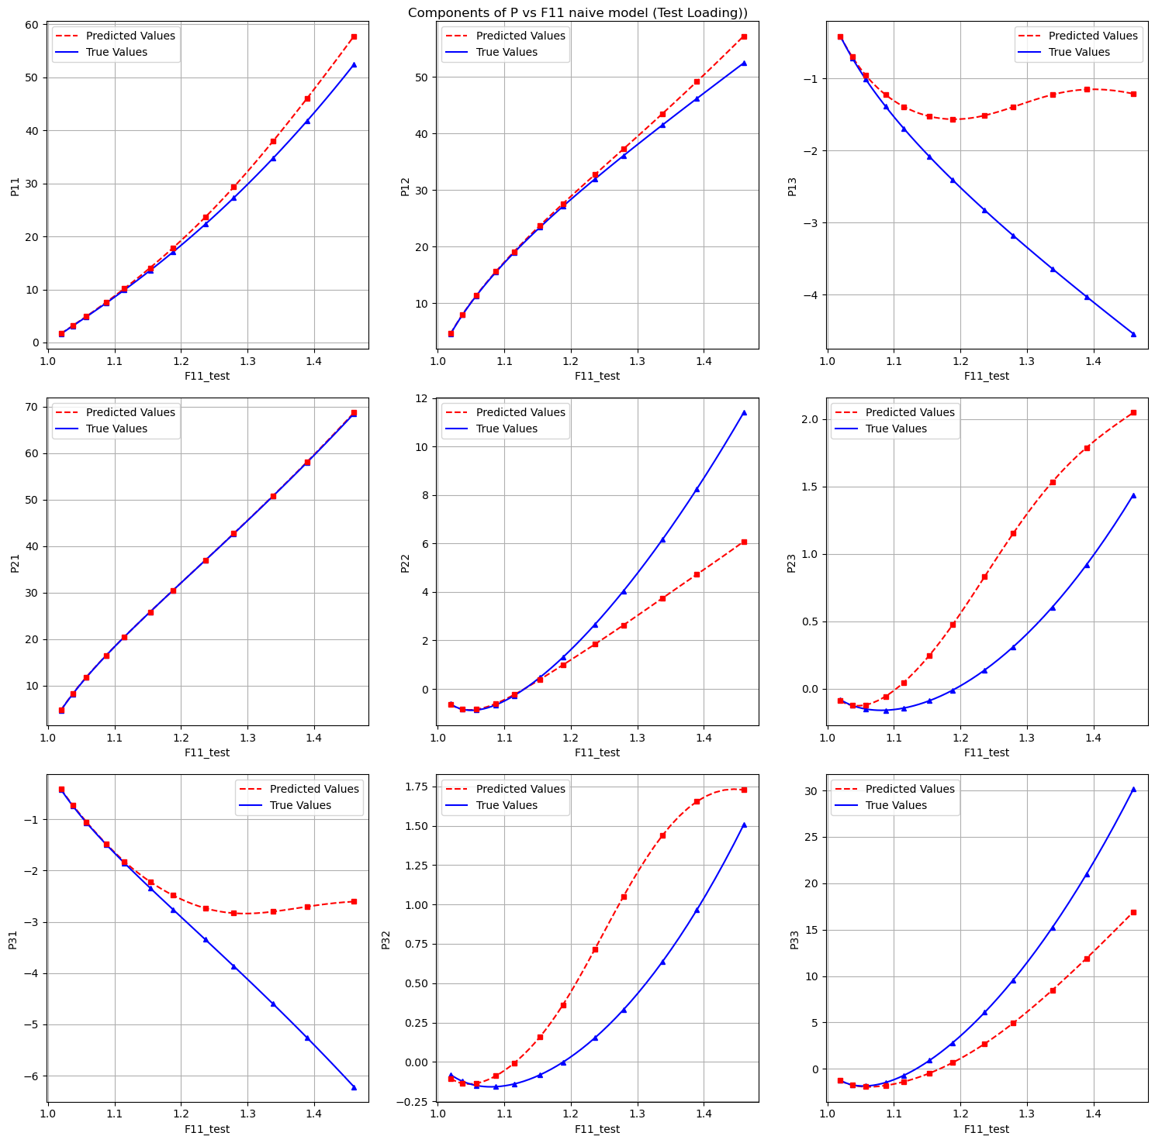
4. Concentric sampled deformation gradients
Components of P vs F11 Calibrate with B2 on 96 files (Test Loading):

Slide 29
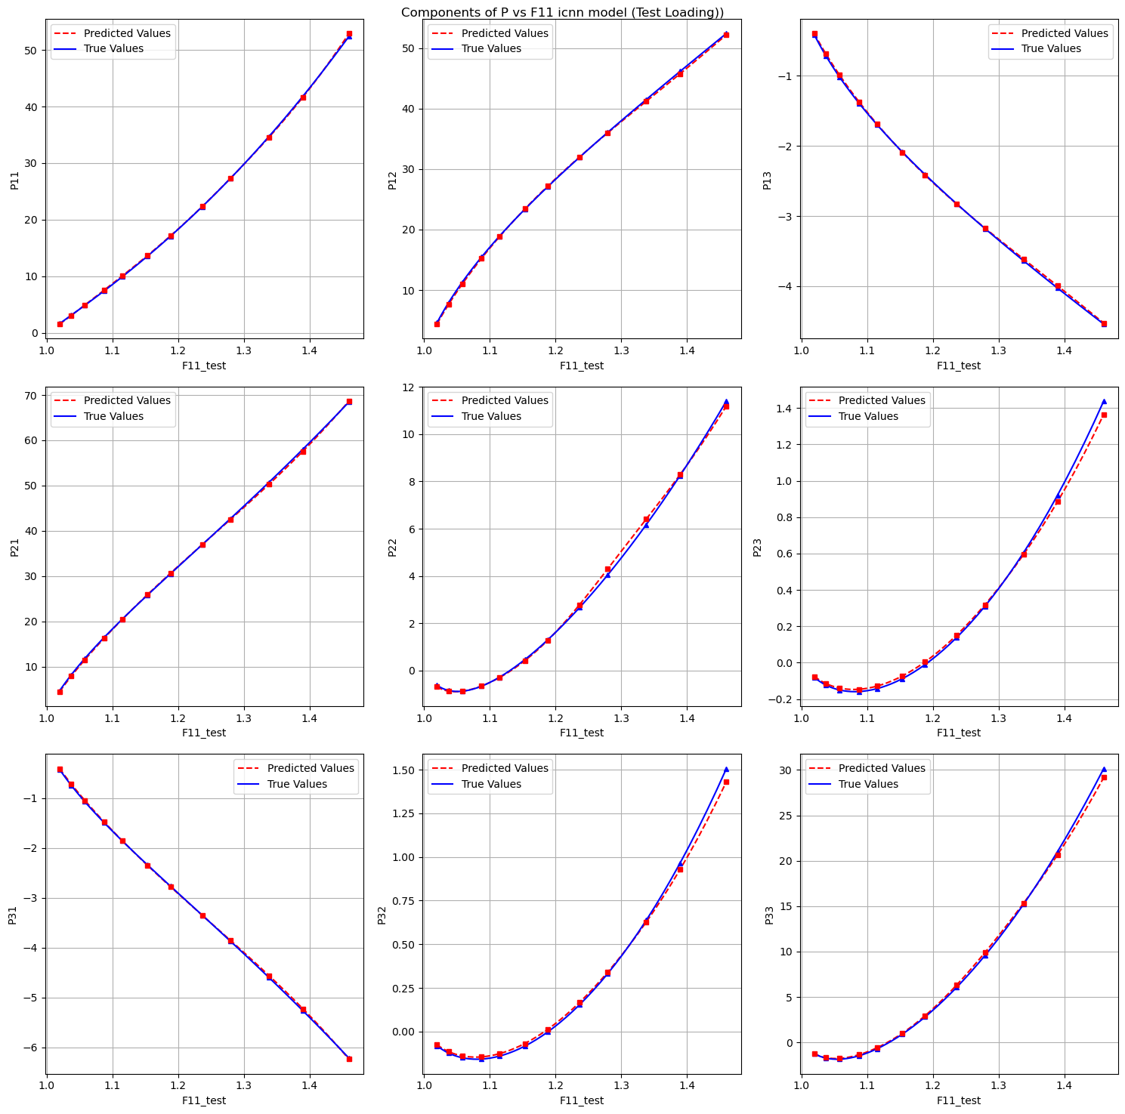
4. Concentric sampled deformation gradients
Components of P vs F11 Calibrate with A2 on 96 files (Test Loading):

Slide 30
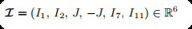
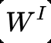
5.1 Data preparation
Introduction
input
output
optimizers
Notes:
Why is it not possible to use batch normalization for this model?
What are the benefits of scaling the output as in eq. (8)?
Is the model able to interpolate the dataset? What could be the challenge with this dataset?

Slide 31
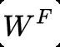
5.1 Data preparation
Introduction
input
output
Notes:
Why is it not possible to use batch normalization for this model?
What are the benefits of scaling the output as in eq. (8)?
Is the model able to interpolate the dataset? What could be the challenge with this dataset?

Slide 32
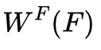
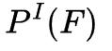
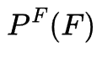
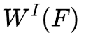
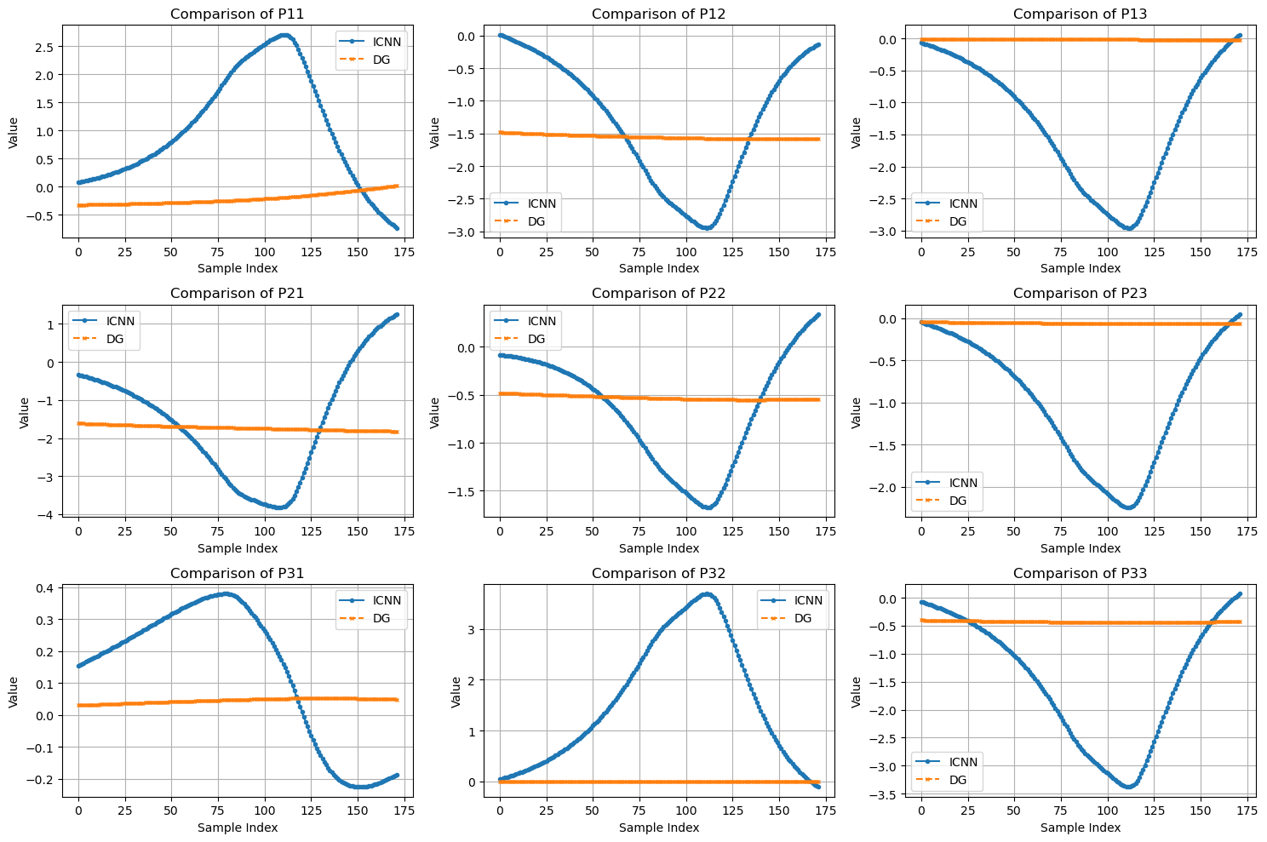
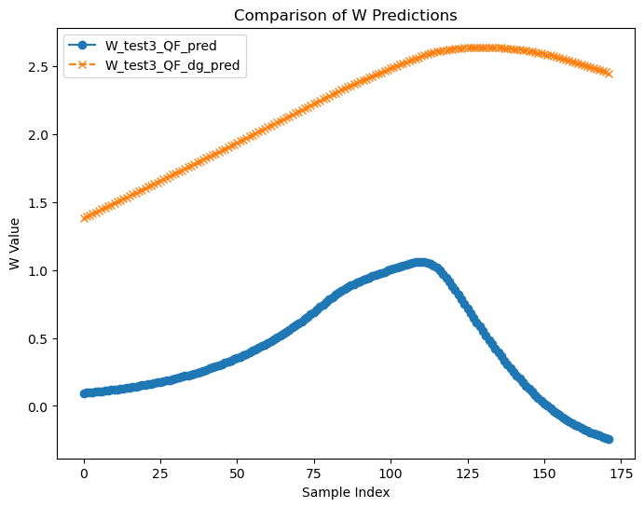
5.3 evaluate the invariance condition
?
?

Slide 33
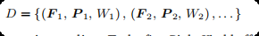
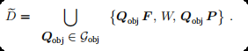
5.4 Data augmentation

Slide 34
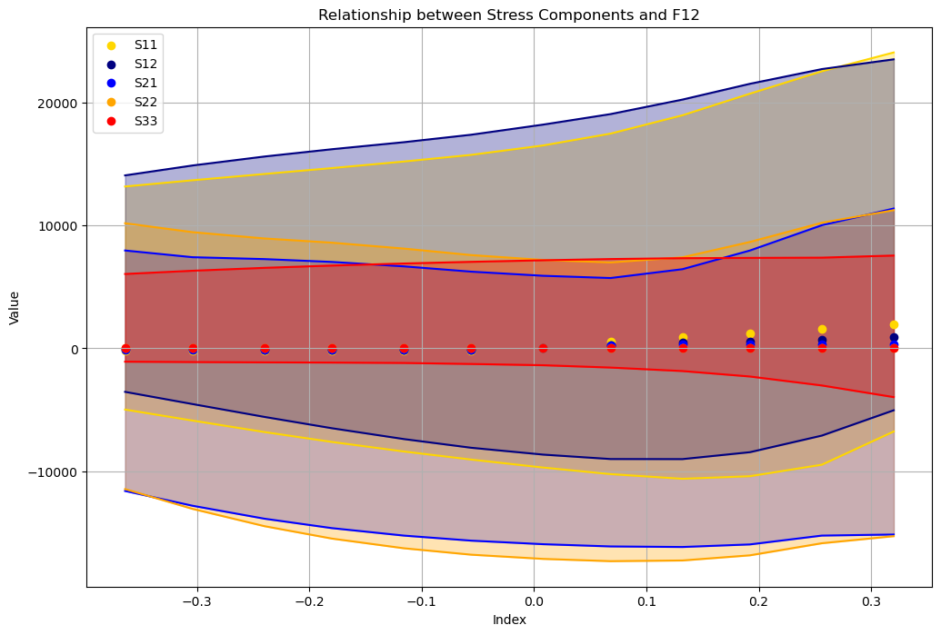
5.4 Data augmentation
8 observer
Notes:
In the following, the model 𝑊 F is calibrated using 8 observers, and all evaluations for the model are carried out with 1,024 random observers

Slide 35
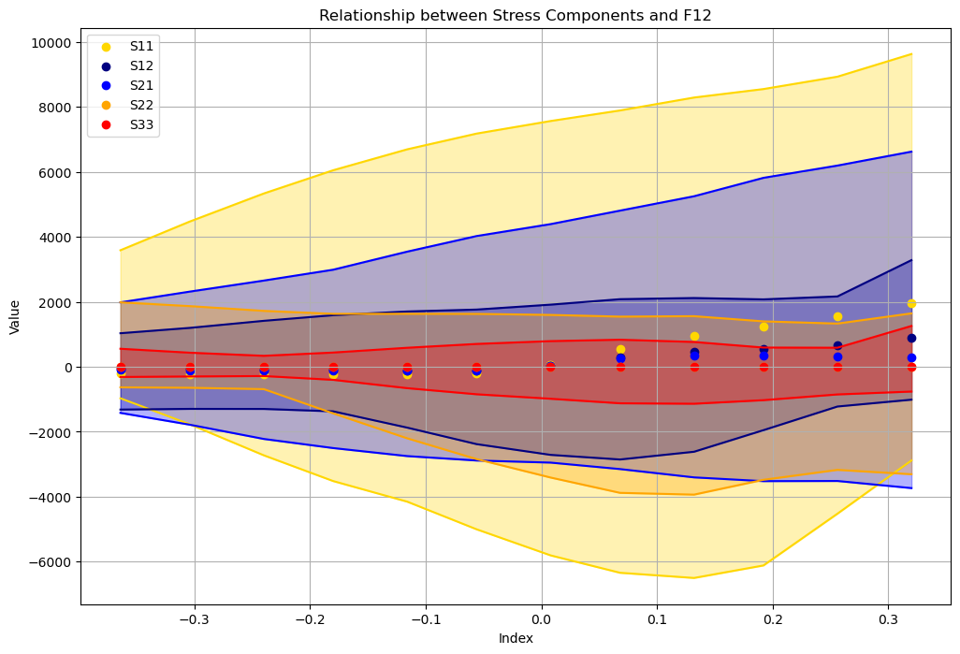
5.4 Data augmentation
16 observer
Notes:
In the following, the model 𝑊 F is calibrated using 8 observers, and all evaluations for the model are carried out with 1,024 random observers

Slide 36
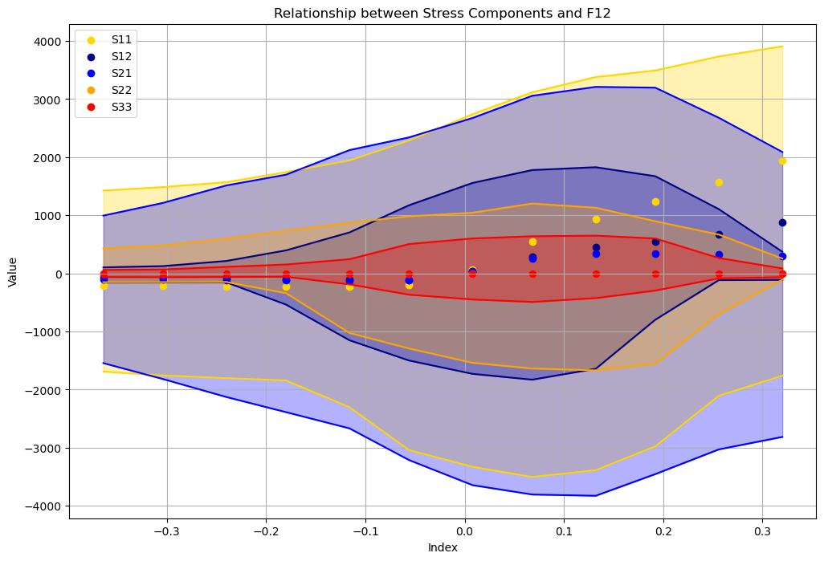
5.4 Data augmentation
32 observer
Notes:
In the following, the model 𝑊 F is calibrated using 8 observers, and all evaluations for the model are carried out with 1,024 random observers

Slide 37
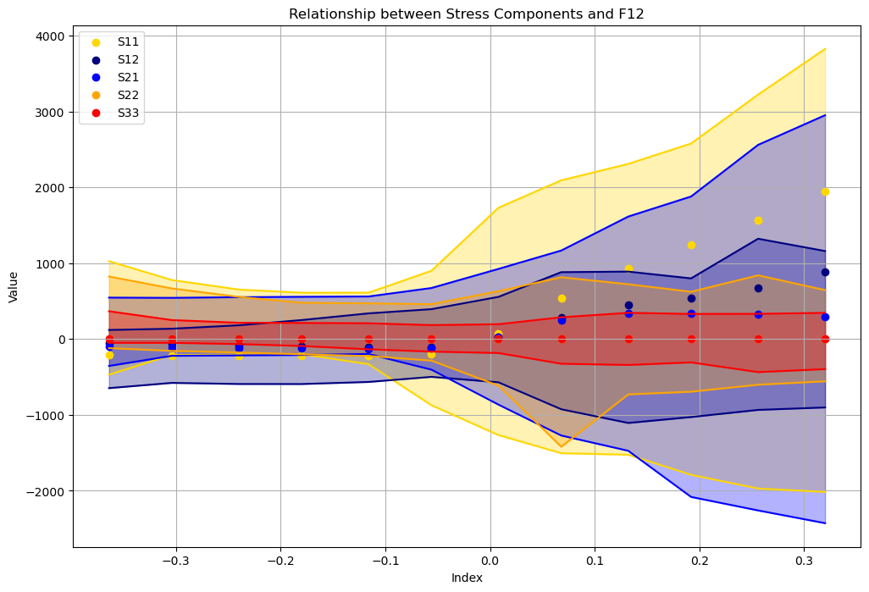
5.4 Data augmentation
64 observer
Notes:
In the following, the model 𝑊 F is calibrated using 8 observers, and all evaluations for the model are carried out with 1,024 random observers

Slide 38
Danke
Xin Xiong, Huasen Luo

